Slide 1
TIC TAC TOE GAME USING
AI STRATEGIES

Slide 2



TEAM MEMBERS OF THE PROJECT
TEJA REDDY
DURGA SYAMALA

Slide 3

Tic-Tac-Toe is a classic game played on a 3x3 grid where players take turns marking spaces with "X" or "O". The objective is to create a line of three of their symbols horizontally, vertically, or diagonally to win. It's often used as a simple example in AI and game theory for decision-making and strategic planning. In this study, we explore the application of AI algorithms in playing Tic-Tac-Toe. Specifically, we focus on comparing the performance of two AI algorithms: Q-learning and Markov Chain Monte Carlo (MCMC). By simulating games between Q-learning and MCMC players, we aim to evaluate their effectiveness in playing Tic-Tac-Toe and understand the strengths and limitations of each approach.
INTRODUCTION

Slide 4

PROJECT OBJECTIVE
The objective of this project is to compare the performance of two different reinforcement learning algorithms, Q-learning and Markov Chain Monte Carlo (MCMC), in playing the game of Tic-Tac-Toe against each other.

Slide 5
STATEMENTS OF PROJECT APPROACH
Experimental Setup:
Simulating games between Q-learning and MCMC players.
Player Classes:
QLearningPlayer: Implements the Q-learning algorithm. This player learns from past experiences to make optimal decisions during the game.
MCMCPlayer: Implements the Markov Chain Monte Carlo (MCMC) algorithm. This player uses Monte Carlo simulations to estimate win probabilities and make decisions accordingly.
TicTacToe Class:
The TicTacToe class manages the game environment and facilitates interactions between the players. It keeps track of the game state, determines game outcomes (win, lose, or draw), and resets the game for subsequent simulations.
Number of Simulations:
A thousand(1000) simulations are conducted to evaluate the performance of the Q-learning and MCMC players. Each simulation involves multiple games of Tic-Tac-Toe, allowing the players to learn and adapt their strategies over time.

Slide 6
Performance Metrics
1. Win Rate: Percentage of games won by each player.
2. Tie Rate: Percentage of games resulting in a draw.
3. Average Game Length: Average number of moves per game.
4. Convergence Speed: Rate of convergence to optimal strategies.
5. Exploration vs. Exploitation Ratio: Balance between exploring new strategies and exploiting learned ones.

Slide 7
1. Q-learning Algorithm:
- Reinforcement learning technique for training agents.
- Learned optimal strategies by updating Q-values.
2. Exploration and Exploitation:
- Balances trying new actions and exploiting known ones.
- Explores to discover new strategies and exploits for maximum rewards.
3. Q-value Updates:
- After each action, update Q-values based on rewards.
Q(s, a) = Q(s, a) + α * (reward + γ * max(Q(s', a')) - Q(s, a))
- Adjusts values towards more accurate estimations.
4. Learning in Tic-Tac-Toe:
- Q-learning agent plays against opponents like MCMC players.
- Refines strategies through iterative gameplay.
5. Performance Improvement:
- Learns optimal strategies over time.
- Improves performance through experience and learning.
Q-LEARNING AGENT

Slide 8
1. Stochastic Simulation Method:
- MCMC is a probabilistic approach used for stochastic simulation.
- It generates samples from a target distribution using Markov chains.
2. MCMC Player Class Features:
- Calculates win probabilities by simulating game outcomes.
- Select moves based on these calculated probabilities.
3. Application in Tic-Tac-Toe:
- The MCMC Player class applies the MCMC algorithm to make decisions in
Tic-Tac-Toe.
- It estimates win probabilities to guide move selection.
4. Comparative Analysis:
- Compares MCMC's performance with Q-learning in terms of efficiency and strategy.
- Evaluate how well MCMC adapts to the game environment and opponent strategies.
Markov Chain Monte Carlo

Slide 9
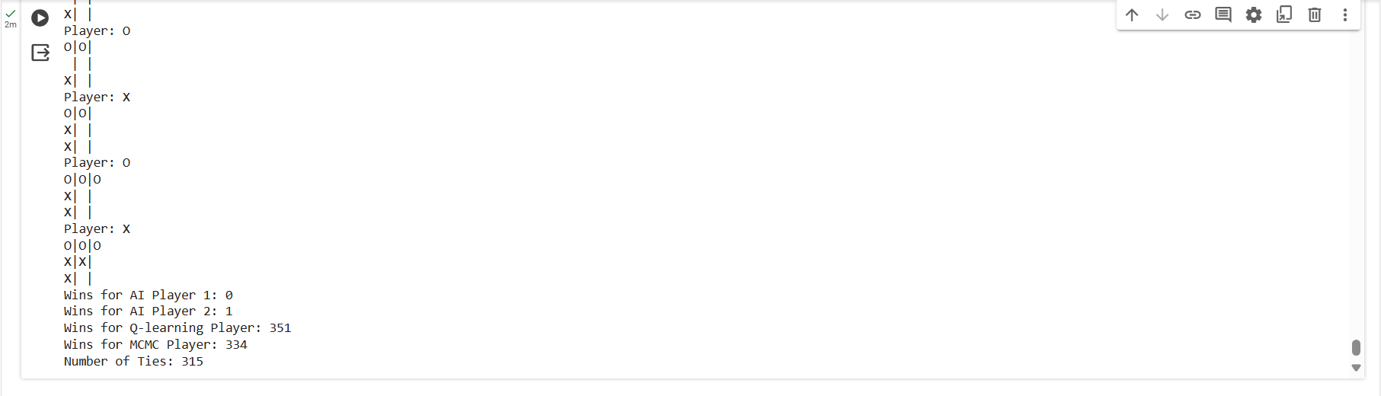
RESULT
Number of wins for each agent and number of ties after 1000 simulations.

Slide 10
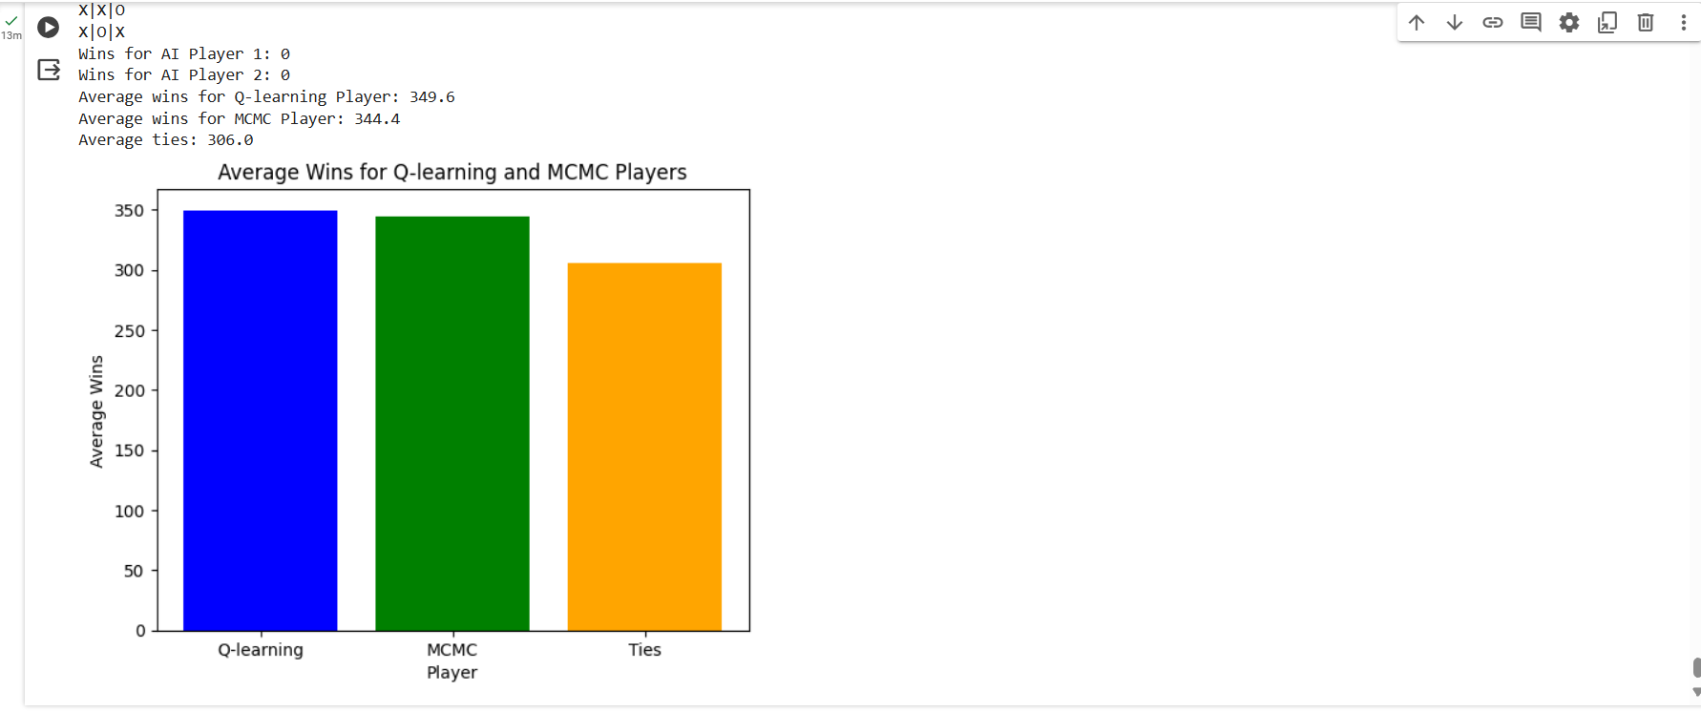
RESULT
The screenshot below shows the average of wins for both the agents and the average ties after 5 runs.

Slide 11
CONCLUSION
Aspect | Q-learning | MCMC
Exploration Strategy | Balances exploration and exploitation to optimize rewards. | Makes decisions based on precalculated win probabilities.
Decision Making | Selects actions with highest expected utility based on Q-values. | Chooses moves with highest likelihood of winning from simulations.
Learning Speed | Learns optimal strategies over time through experience. | Makes immediate decisions based on current win probabilities.
Complexity | Suitable for dynamic environments with complex states and actions. | Efficient for simple games like Tic-Tac-Toe with accurate win estimations.

Slide 12


